Slide 1





Mindfulness Tools
to Manage Emotions
for Educators
Barbara J. Faison

Slide 2
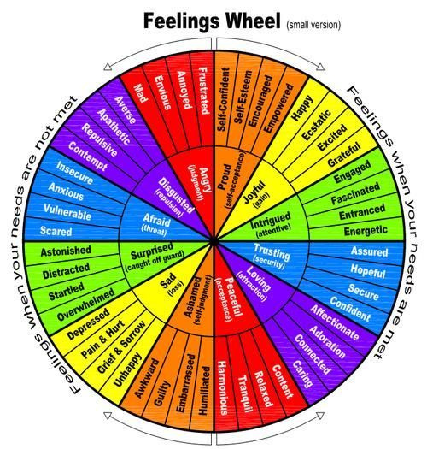
Six primary emotions:
  sad
  angry
  scared
  powerful
  peaceful
  joyful
Developed by Gloria Wilcox

Slide 3
How are You Feeling Right Now?
Anxious
Calm
Stressed
Excited
Sad
Happy
Bored
Worried

Slide 4




Mindfulness Strategy
S. T. O. P.
STOP
TAKE A BREATH
OBSERVE
PROCEED
Press pause on what
you are doing
for a few moments.
Inhale and exhale to focus on your breath to ground yourself in the moment
Your emations, feelings, bodily sensations
What is your next best step?

Slide 5




Mindfulness Tools
Set your phone to alarm a few times during the day to check in with your emotions
Practice S.S.H.T.T.S. - notice your senses - sight, smell, hearing, taste, touch & sensations
Say or write down what you are grateful for
1 - 2 minutes

Slide 6
Mindfulness Tools (cont)
Rub your hands together then massage your scalp, face, ears and center of your chest
Gently tap the center of your chest as you take deep breaths in and out for 1 -2 minutes
Stand with your feet hip width apart, bend your knees slightly and bounce gently for 2 -5 minutes

Slide 7
More Tools You Can Use
  Movement
    Mindful walking - walk around and focus on feeling when your feet move from the heel to the ball of your foot
    Dance - put on songs and get up and dance!
  Music
    Create playlists for different moods like happy, workout & relaxation
    Listen to your favorite music and sing along with the songs
  Memories
    Remember experiences that make you happy and take yourself there
    Write down events or times you felt good and reference them

Slide 8



REMEMBER:
You can take 600 seconds out of the day for yourself. Step outside, place your hands in your heart space and take 1 - 10 deep breaths.

Slide 9
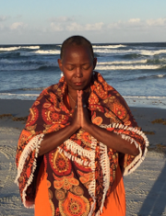

I'd love to know your thoughts about my presentation...
Click here for a
2 question evaluation form...
THANK YOU SO MUCH!

